Slide 1



Stream Stock Trend
Team Members:
Patel Preet
Tandel Manasvi
Patel Sujal
Dalal Kush
Guided by:
Abdul Aziz Md, Master Trainer, Edunet Foundation

Slide 2
Stream Stock Trend
OUTLINE
Abstract
Problem Statement
Aims, Objective & Proposed System/Solution
System Design/Architecture
System Development Approach (Technology Used)
Algorithm & Deployment
Conclusion
Future Scope
References
Video of the Project
Notes:
These are the list of chapters that we are going to cover in these foundation codes. Those are chapter one what are AI and ML? chapter 2 applied Python programming in AI, and chapter 3 is exploratory data analysis for ML.

Slide 3
Abstract
Stream Stock Trend
Stock Trend Predication
This study investigates the historical challenges faced by us in the stock market, particularly focusing on personal obstacles such as paperwork and administrative burdens. As a student investor, navigating the complexities of the stock market often involves grappling with cumbersome paperwork requirements, including account setup forms, transaction documentation, and regulatory filings. These administrative tasks can pose significant barriers, consuming time and resources, and impeding students' ability to focus on learning and investment strategies. We implement it by machine learning-based LSTM (Long Short-Term Memory) model. Through LSTM algorithms, the LSTM-UI model generates intuitive indicators, allowing users to easily understand when to buy or hold stocks. Through empirical analysis and user testing, this study demonstrates the effectiveness of the LSTM-UI framework in empowering users with accessible and actionable insights. Through qualitative analysis and experiential insights, this study explores the impact of reducing administrative burdens on learning outcomes in the stock market. We findings the user-friendly solutions to promote financial literacy and facilitate meaningful engagement in the stock market.

Slide 4

Problem Statement
Stock Trend Predication
Stream Stock Trend
This study examines the challenges encountered by us, in participating in the stock market, with a focus on administrative hurdles such as paperwork. Historically, engaging in stock market activities has involved burdensome paperwork requirements, including account setup forms, transaction documentation, and regulatory filings. These administrative tasks often consume time and resources, detracting from the overall user experience and limiting participation in investment opportunities.

Slide 5
Aim and Objective
Stream Stock Trend
Stock Trend Predication
Aim: The aim of this project is to develop a basic level system that predicts whether to buy or not buy a stock based on stock trend predictions using Artificial Intelligence and Machine Learning (AIML) techniques
Objective: Gather historical stock data from reliable sources such as financial databases or APIs. Clean and preprocess the collected data to ensure consistency and remove any inconsistencies or missing values. Develop a basic AIML model, such as a binary classifier, using simple algorithms like logistic regression or decision trees, to predict whether to buy or not buy a stock based on the selected features. Train the AIML model using historical stock data, splitting the dataset into training and testing sets to evaluate model performance. Test the system with new or unseen data to validate its effectiveness and reliability in making stock buying decisions. Document the project including data sources, methodology, implementation details, and results to provide transparency and reproducibility. Identify potential future enhancements and extensions to the project, such as incorporating additional features, exploring advanced AIML techniques, or integrating with trading platforms.

Slide 6
Proposed Solution
Stock Trend Predication
Stream Stock Trend
Data Collection: Gather historical stock data and relevant factors (financials, news sentiment).
Data Preprocessing: Clean and format data for machine learning algorithms.
Model Training: Train an LSTM or RNN model on historical data to identify patterns.
Evaluation & Refinement: Evaluate the model's accuracy and refine as needed.
Prediction & Visualization: Use the model to predict future trends and visualize them.

Slide 7
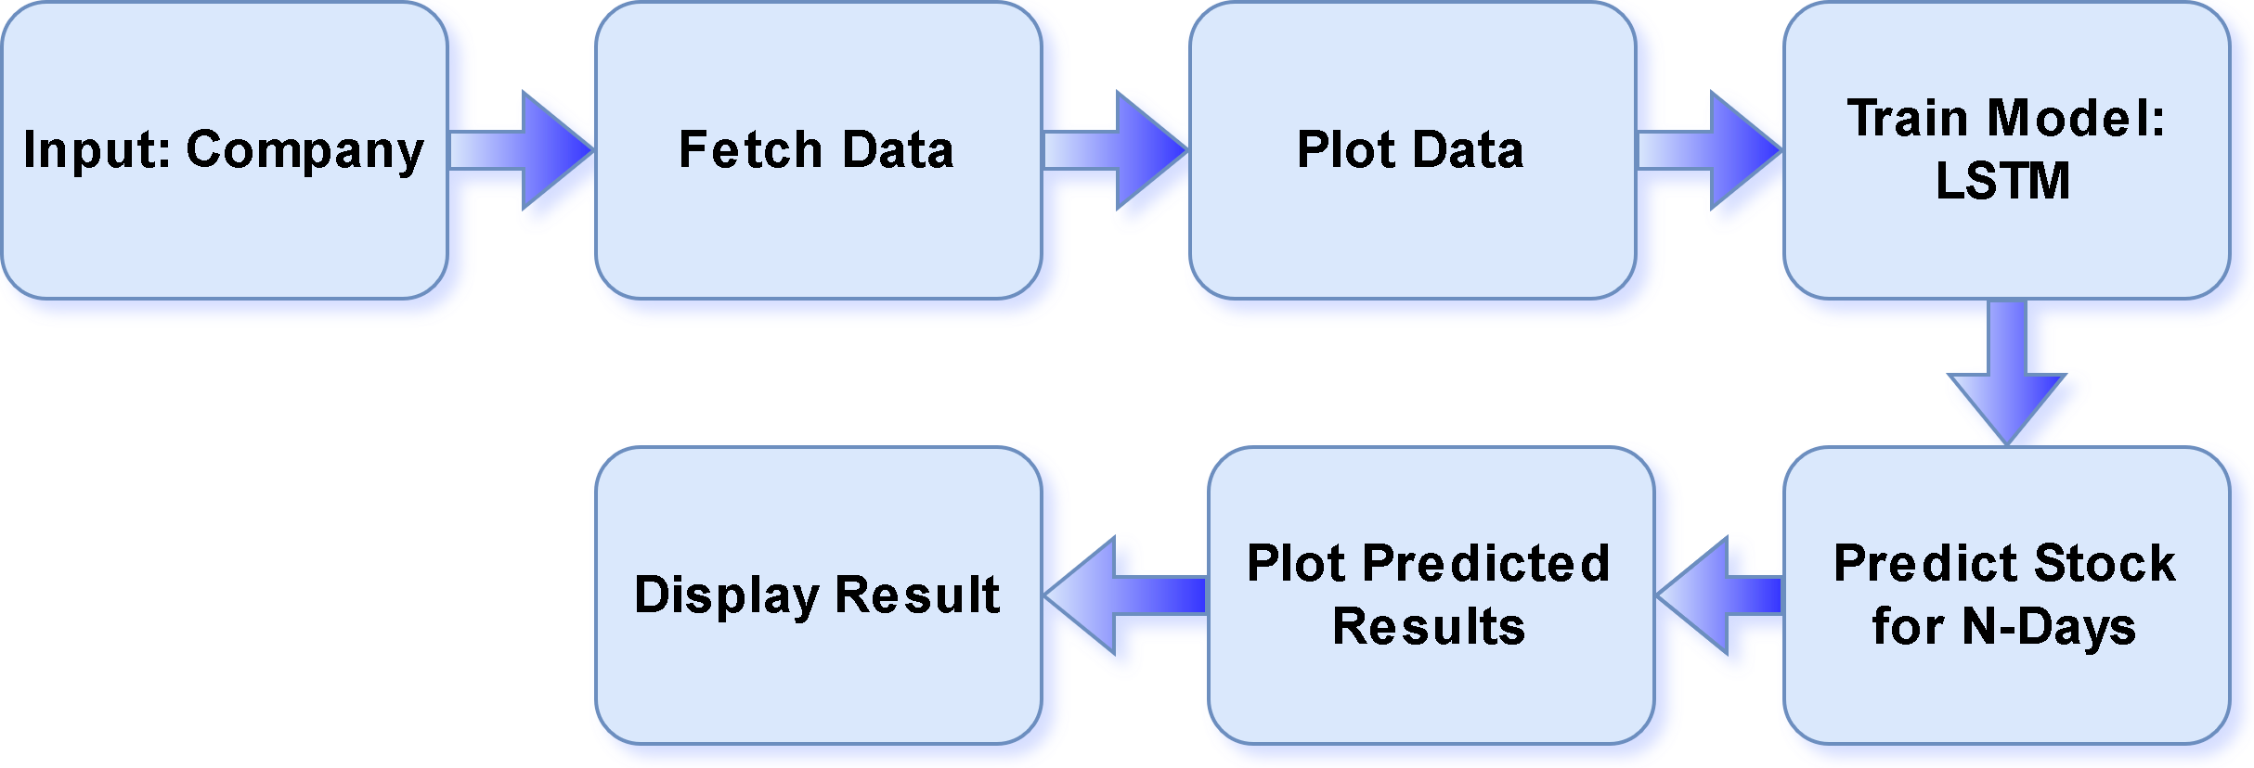
System Architecture
Stream Stock Trend
Stock Trend Predication

Slide 8

System Deployment Approach
Stream Stock Trend
Stock Trend Predication
Cloud/On-Premises: Microsoft Azure
Containers (Optional): Dockerize for portability, scalability.
Real-time/Batch: Efficient models & data pipelines for real-time; less stringent latency allows complex models for batch.
Secure API: User input, prediction, result return with authentication/authorization for external users.
Monitor & Secure: Track performance, secure access, encrypt data, update software.
Version Control & CI/CD: Track changes (Git), automate testing/deployment.
Scale & Optimize: Auto-scale for demand, monitor and optimize model performance.

Slide 9

Algorithm & Deployment
Stock Trend Predication
Stream Stock Trend
Algorithm
LSTM: LSTM stands for Long Short-Term Memory, a type of recurrent neural network (RNN) particularly useful for analyzing sequential data like stock prices. Unlike standard RNNs, LSTMs can handle long-term dependencies in data thanks to their special architecture with a cell state and a gating mechanism. This allows them to learn and remember important information from the past, which is crucial for capturing trends in stock prices.
Deployment
Real-time vs. Batch (Efficiency, latency)
Infrastructure (Cloud, containers)
API Integration (Documented, secure)

Slide 10

Conclusion
Stream Stock Trend
Stock Trend Predication
In conclusion, the development and implementation of this basic level project on stock trend prediction for stock buying decisions using AIML represent a significant step towards understanding the application of Artificial Intelligence and Machine Learning in financial decision-making. Through this project, we have gained valuable insights into the process of analyzing historical stock data and utilizing AIML algorithms to provide actionable recommendations for investors. Our project focused on predicting whether to buy or not based on stock trend predictions, employing simple AIML techniques and LSTM Model. By leveraging AIML to analyze historical stock data and identify patterns indicative of future price movements, investors can mitigate risks and capitalize on opportunities in the dynamic stock market environment.

Slide 11
Future Scope
Stock Trend Predication
Stream Stock Trend
This basic level project represents just a small step in our journey, it underscores the transformative potential of AIML in revolutionizing financial decision-making. By continuing to learn, experiment, and innovate, we can unlock new possibilities and empower individuals to navigate the complexities of the stock market with greater confidence and efficiency. By analyzing the financial data of the company and other data of the company, using such an algorithm will predict whether the stock should be buy or not.

Slide 12
Stock Trend Predication
Stream Stock Trend
Reference
https://youtu.be/s3CnE2tqQdo?si=AZ9RFevIqYaNFJs-
https://github.com/034adarsh/Stock-Price-Prediction-Using-LSTM
https://streamlit.io/components
Notes:
Reference
These are the references for this session.
12

Slide 13
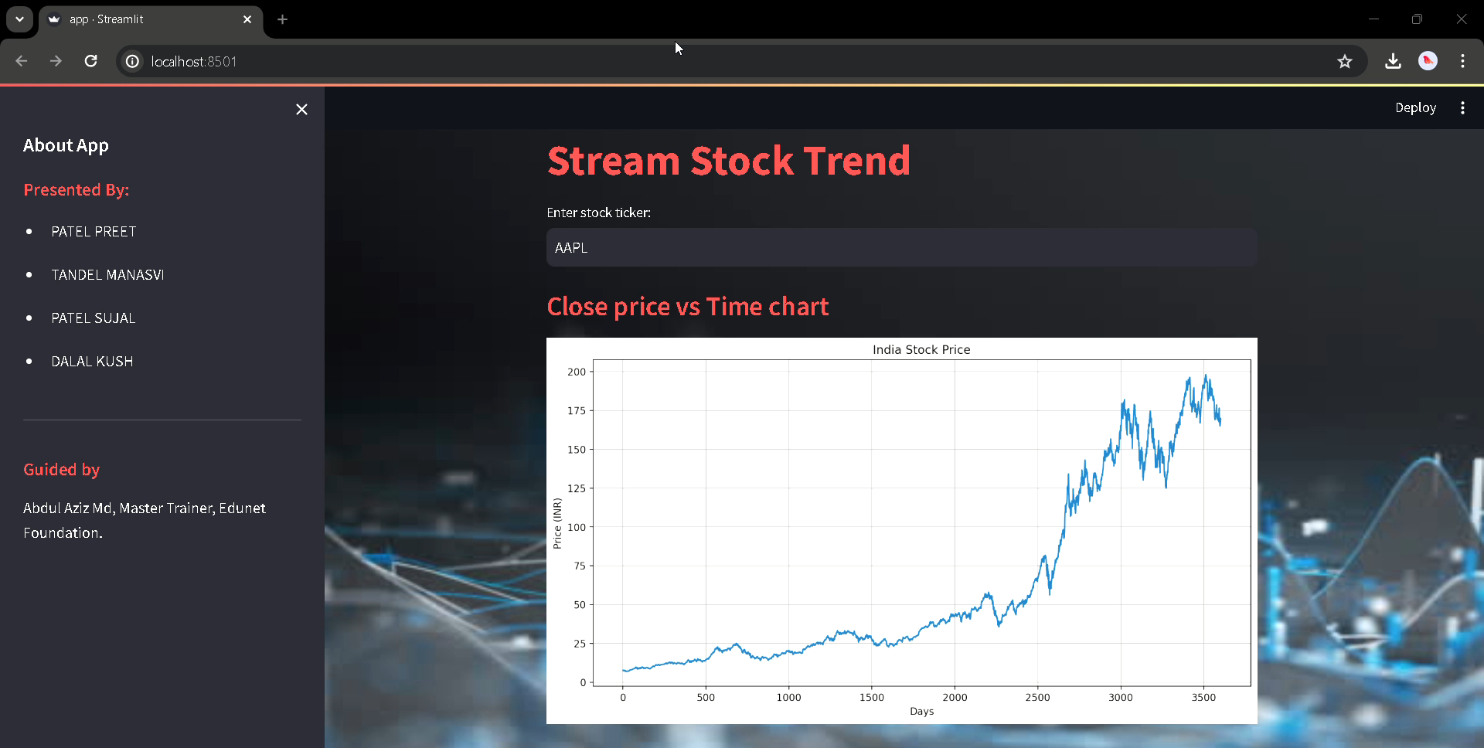
Stock Trend Predication
Stream Stock Trend

Slide 14

THANK YOU
Stock Trend Predication
Stream Stock Trend
Notes:
thank you very much for joining this PPT, keep learning.
14

